Slide 1
Urban land-use mapping using a deep convolutional neural network with high spatial resolution multispectral remote sensing imagery
Deteção Remota Multiespectral Sílvia Mourão fc57541
FCUL, 17/05/2022

Slide 2




Index
Introduction
Area of Study
Methodology
Results

Slide 3
Introduction
Objective: creating an urban land-use map from high spatial resolution multispectral remote sensing images
Classic Techniques
Pixel Classification
Object Classification
Graph-Based Classification
Problems
High spatial resolution images are very complex
Methods are very dependent on the classification system
They require previously acquired information about the terrain
The images need to be divided into small uniform processing units

Slide 4
Introduction
Deep Learning – Convolutional Neural Network is a possible solution that obtains good results
Problem: for HSR images it requires a high number of layers which translates into an elevated number of training samples
Two proposed solutions: transfer learning and small DCNN - not directly applicable to HSR images
Creation of a new method: STDCNN – combines both solutions
Proposed use of a skeleton based decomposition method instead of uniform processing units

Slide 5
Area of Study
Hong Kong
WorldView-3
1.24m
8 channels
Shenzhen
WorldView-2
0.5 m
4 channels

Slide 6
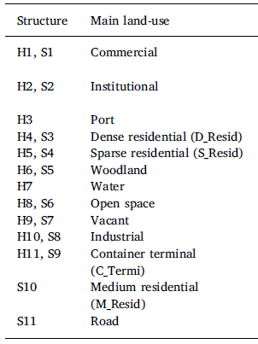
Area of Study
The authors considered 11 different classes for training

Slide 7
Area of Study
Hong Kong = 36 training samples, 15-25 testing samples
Shenzhen = 40 training samples, 30 testing samples
Dimension 256 x 256 px

Slide 8
Methodology
Creation of STDCNN:
Transferred DCNN uses AlexNet trained set – allows the STDCNN to gain a deep architecture
Small DCNN with reduced level of convolution and pooling layers – can work with multispectral images
Two final layers - fully connected and softmax – join the results of the two paths

Slide 9
Methodology
Decomposing the image with the skeleton based method
For each area of the skeleton all processing units belonging to that area are used
Results are combined to generate the land-use map

Slide 10
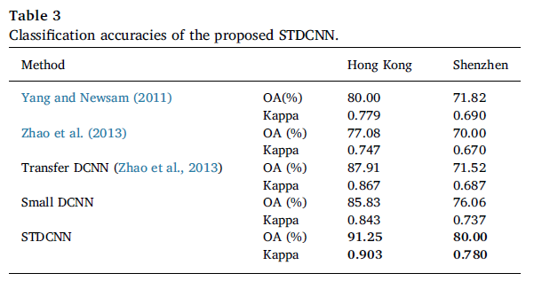
Results
STDCNN proposed method was tested versus other methods previously proposed by other authors
Confusion Matrices created for each case
Two indicators considered – Overall Accuracy (OA) and Kappa Coefficient

Slide 11
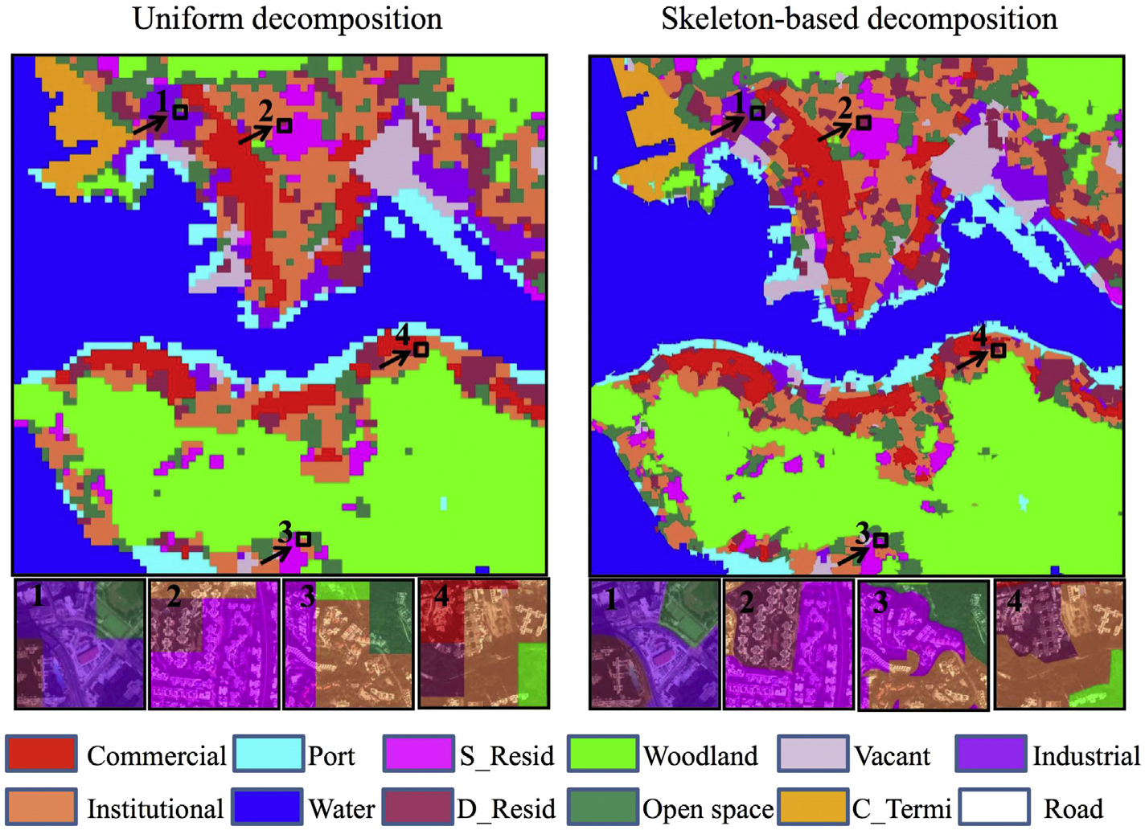
Results
Land-use maps created with skeleton-based decomposition and uniform decomposition methods
Skeleton-based decomposition obtained better, smoother results

Slide 12
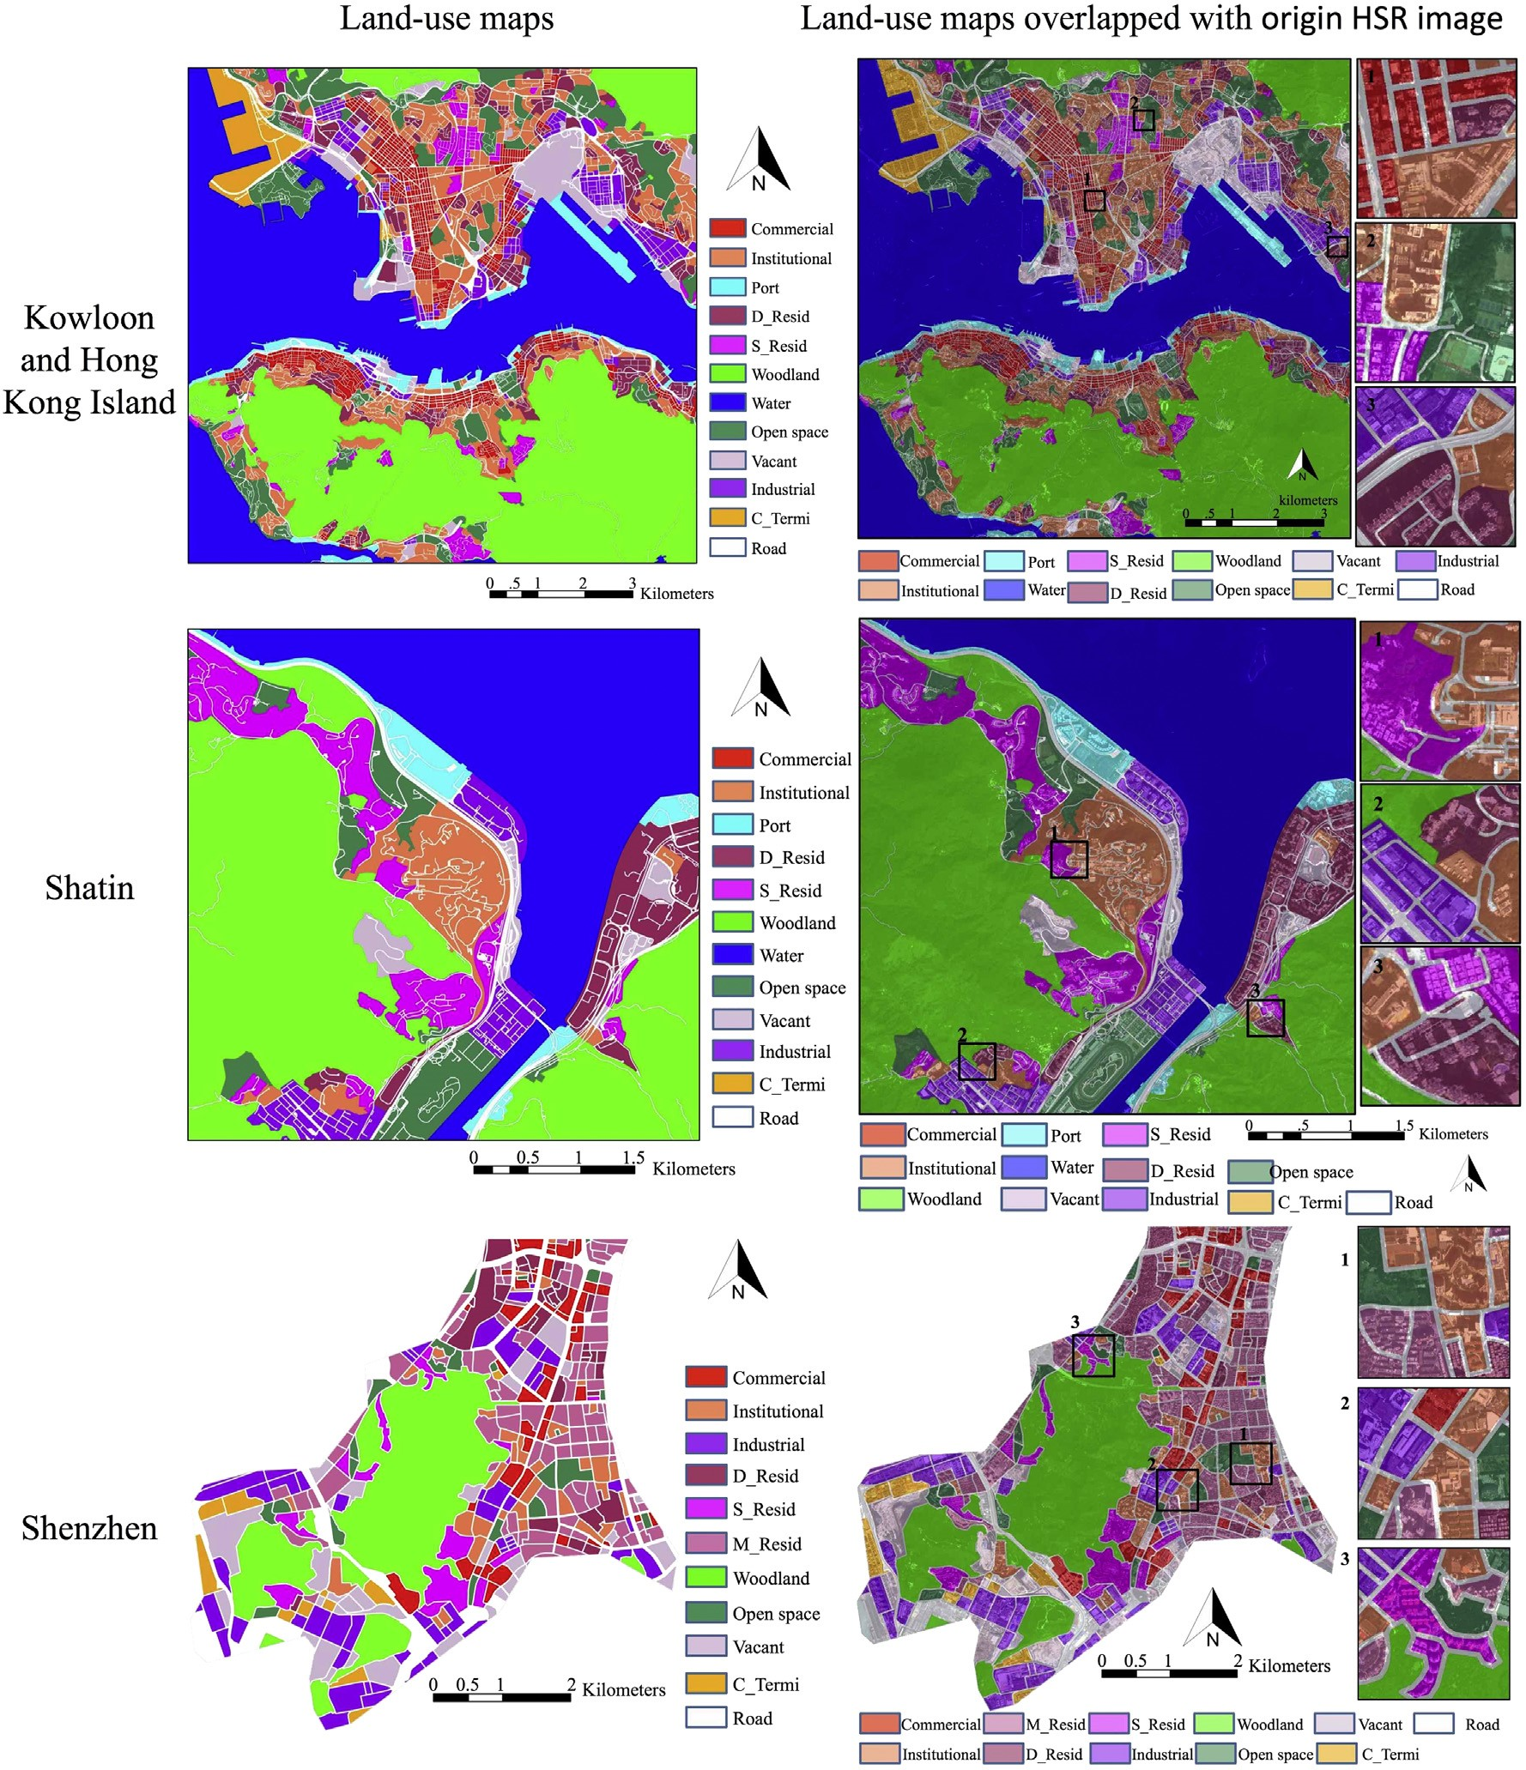

Slide 13
Huang, B.; Zhao, B.; Song, Y. Urban Land-Use Mapping Using a Deep Convolutional Neural Network with High Spatial Resolution Multispectral Remote Sensing Imagery. Remote Sensing of Environment 2018, 214, 73–86. https://doi.org/10.1016/j.rse.2018.04.050

